Slide 1
MQTT: Learn From Home
Nicholas Robinson
6th April 2020

Slide 2
Overview
These slides will show an example which can be done at home:
Publish / Subscribe from a Wi-Fi microcontroller to MQTT broker
Publish / Subscribe to an MQTT broker from python
Speed comparison between HTTP and MQTT
Hardware used
ESP8266 HUZZAH Feather (https://www.adafruit.com/product/2821)
Feather Relay (https://www.adafruit.com/product/3191)
MQTT Broker
https://io.adafruit.com/

Slide 3
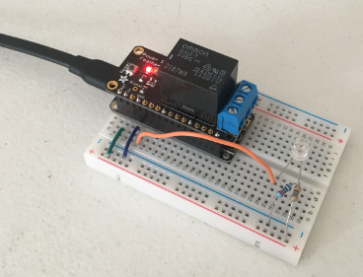
The “Lab” Setup

Slide 4
Reference
All Code for this example
https://github.com/Freeno83/MQTT-Learn-from-home
Adafruit IO API (HTTP and MQTT)
https://io.adafruit.com/api/docs/
Requests Library explanation
https://requests.readthedocs.io/en/master/
Paho MQTT Library explanation
https://www.hivemq.com/blog/mqtt-client-library-paho-python/

Slide 5
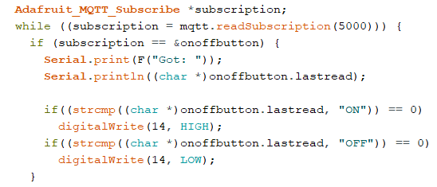
Program the Microcontroller + Setup a Feed
Start with this tutorial: learn.adafruit.com/mqtt-adafruit-io-and-you?view=all
Based off Adafruit MQTT Example sketch ‘MQTT_esp8266’
In this case, pin 14 controls the relay
Use string compare to make on/off decision

Slide 6
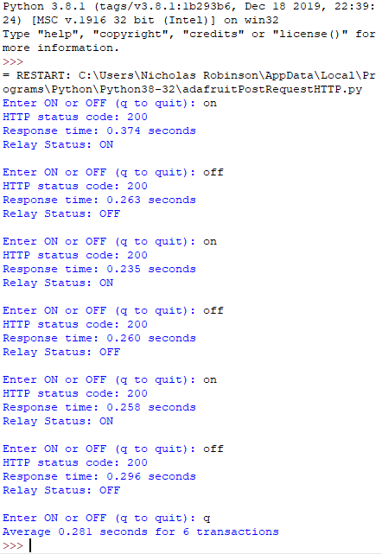
HTTP
Run from python shell
Send to response:
Average 0.281 s for 6 transactions

Slide 7
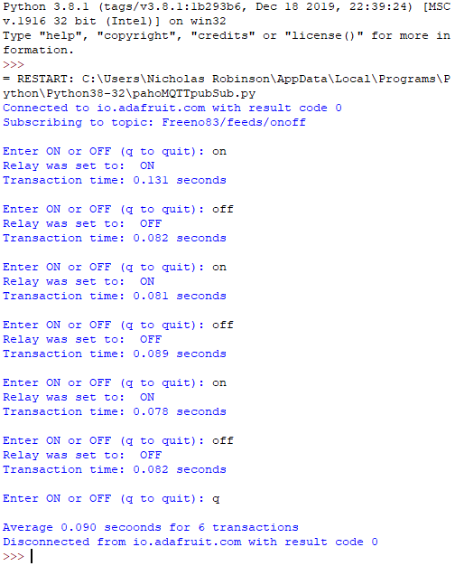
MQTT
Run from python shell
Send to response:
Average 0.090 s for 6 transactions

